Slide 1
Mental set
Kahoot
https://play.kahoot.it/#/?quizId=1f524270-1eeb-403d-91c9-4f011db3391d
Notes:
hook

Slide 2
24
7
30
Date
Title
EQ –
5
Notes:
Lesson objective (EQ)

Slide 3
Lesson objective
By the end of this lesson you will be able to;
-
Notes:
Lesson

Slide 4
Success Criteria
You will know you are successful in achieving the objective by…

Slide 5
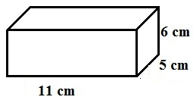
24
7
30
Date
Surface Area of Rectangle & Triangle Prisms
EQ – How do you work out surface area of a rectangular prism
Surface Area –
Example
This rectangular prism has 6 sides, top, bottom, left, right front and back. By working out the area of each of these faces then adding them together you get the surface area of this prism.
The Surface Area of a solid is the total area of each face of the solid.
5
Notes:
Input

Slide 6
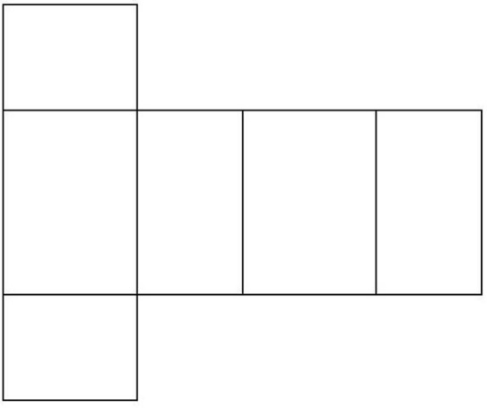
24
7
30
Date
Surface Area of Rectangle & Triangle Prisms
EQ – How do you work out surface area
Use the shape net. A shape net is a flattened out view of a three dimensional shape.
From this view there are 2 ends and the other 4 rectangles form 1 large rectangle. The surface area can be found by finding the area of the two ends and add to that the area of the large rectangle.
Ends = 2(6x5) = 2x30=60
Large rectangle = (6+5+6+5)x11 = 22x11 = 242
Surface Area = 60 + 242 = 302 cm².
5
Notes:
Input

Slide 7
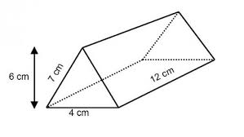
24
7
30
Date
Surface Area of Rectangle & Triangle Prisms
EQ – How do you work out the area of a triangular prism
With a triangular prism there are 2 triangles and three rectangles. With the picture above there are 2 rectangles the same size and the third one is different. Find the area of all 5 faces then add them together.
2 triangles = 4x6/2 = 24 cm²
2rectangles = 2(7x12) = 168 cm²
1 rectangle = 4x12 = 48 cm²
Surface area = 24+168+48 = 240 cm²
5
Notes:
Input

Slide 8
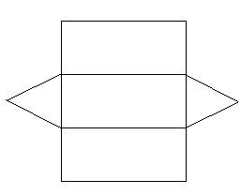
24
7
30
Date
Surface Area of Rectangle & Triangle Prisms
EQ – How do you work out the area of a triangular prism
Using the shape net
There are 2 triangles and 1 large rectangle.
2 triangle = 2(1/2 x 6x4) = 24 cm²
1Rectangle = (7+7+4)x12 = 216 cm²
Surface area = 24 + 216 = 240 cm²
5
Notes:
Input

Slide 9
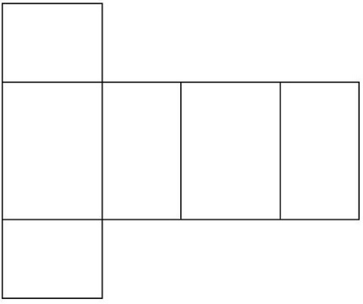
Guided Practice
Find the surface area of a rectangular prism with w=8cm, l=6cm, h=3cm
Draw shape net.
2 ends =
1 rectangle =
Surface area =
Notes:
Do balance of calculations on the board; Ends 2(8x6) = 96; rectangle (8+6+8+6)x3=84;SA=96+84=180

Slide 10
Activity
Notes:
Independent practice

Slide 11
Activity
Notes:
Independent practice

Slide 12
Closure activity
Thumbs up
Notes:
Closure

